Slide 1
IOT BASED SMART IRRIGATION SYSTEM
Shakthivel. R

Slide 2
BLOCK DIAGRAM

Slide 3
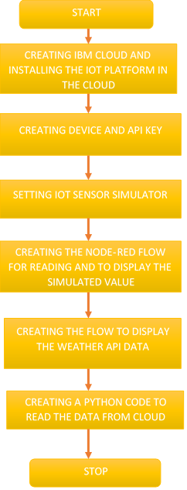
steps

Slide 4
THANK YOU ALL

